Slide 1
LICENSE PLATE RECOGNITION

Slide 2
Introduction
License plate recognition system is also known as LPR.
characters from video footage are automatically recognized and recorded for security & traffic analysis purpose.
Involves low-level image Processing techniques with higher level of Artificial Intelligence techniques.

Slide 3
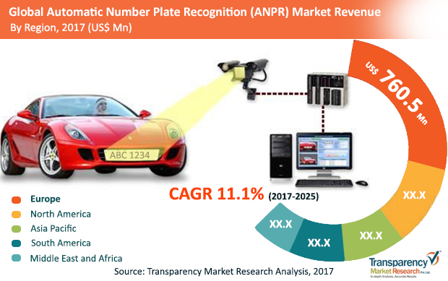
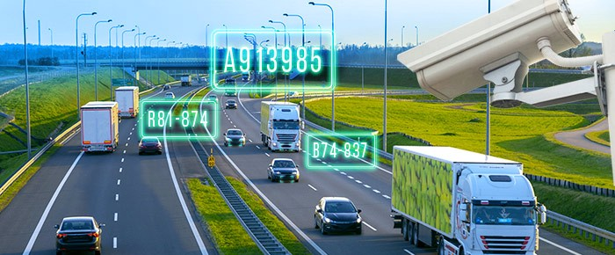
Problem Statement
To create an affordable solution through image processing of number plates of vehicles for the detection, identification and monitoring of vehicles in different scenarios such as residential societies, tolls, business complex, parking spaces etc.

Slide 4
Features
Real-time monitoring.
Position Tracking.
Processes multiple license plates quickly and accurately in less time.
Reliable Performance, with Low False Positives.
Works even with misaligned letters in the license plate.
Supports capture of License Plate along with the car image.

Slide 5
Solution Steps
Create a Database containing images of vehicles of residence including their license plate number.
Train a machine learning module to detect and recognize vehicles.
Process the live video feed frame by frame from security cameras and apply image processing techniques such as Edge Detection and Binarization.
Remove background noise and crop only the area with the license plate.
Apply Optical Character Recognition to recognize the text in the number plate.
Compare the Vehicles image and its number plate details with the details stored in the database.

Slide 6
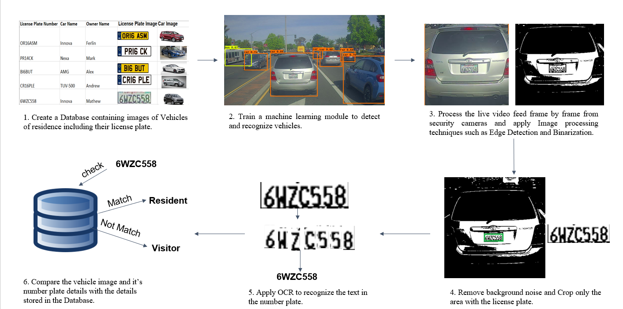
Solution Steps

Slide 7
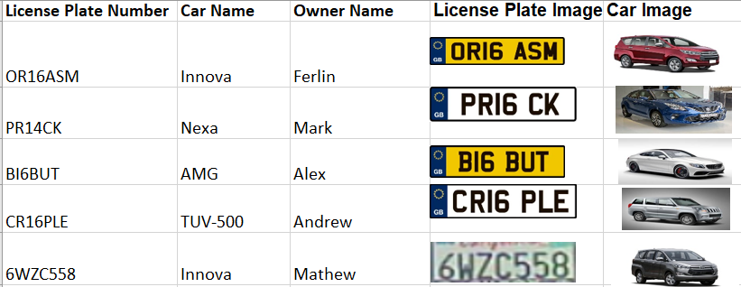
1. Create a Database containing images of vehicles of residence including their license plate number.

Slide 8
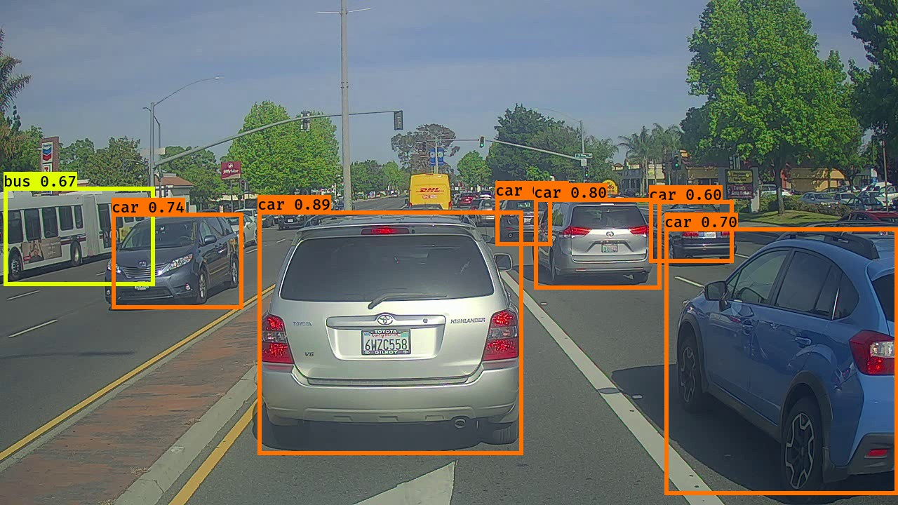
2.Train a machine learning module to detect and recognize vehicles.

Slide 9
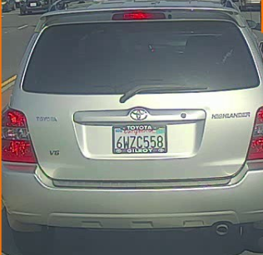
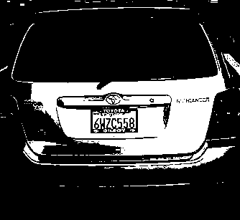
3. Process the live video feed frame by frame from security cameras and apply image processing techniques such as Edge Detection and Binarization.

Slide 10
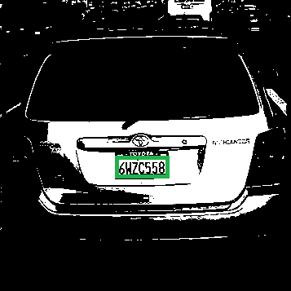
4. Remove background noise and crop only the area with the license plate.

Slide 11
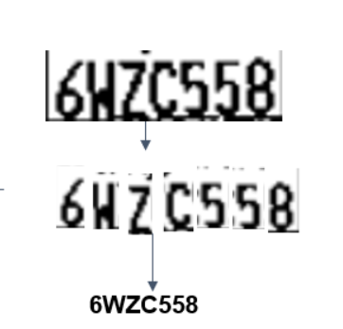
5. Apply Optical Character Recognition to recognize the text in the number plate

Slide 12
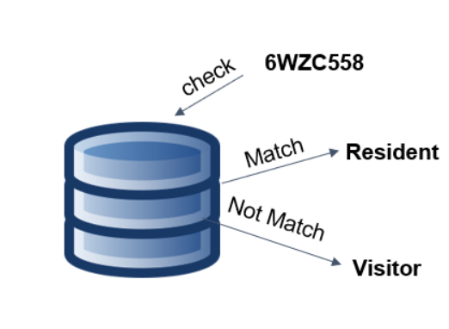
6.Compare the Vehicles image and its number plate details with the details stored in the database.

Slide 13
Applications
Automatic highway toll collection systems.
Analysis of traffic during peak periods.
Enhanced vehicle theft prevention.
Effective law enforcement.
Effective enforcement of traffic rules.

Slide 14
Thank You

